Slide 1

Office Ergonomics
Setting up your workstation to avoid discomfort and pain.
Notes:
Hello and welcome to this ergonomic awareness training. In this video, we will help you set up your workstation to avoid discomfort and pain.
Please make sure you are at your workstation for the duration of this training.

Slide 2
Training Goals
Understand importance of ergonomics
Identify common risk factors that may increase injury risk
Adjusting your workstation set-up
Practice healthy work habits and techniques
Select the proper work tools and equipment
Know how to obtain additional assistance if needed
Notes:
Here are the goals for today’s training.

Slide 3

Training Outline
Definitions
Musculoskeletal Disorders
Postural Risk Factors
Workstation Basics
Rest Breaks
Notes:
We will start by defining some key terms before reviewing important information on musculoskeletal disorders, postural risk factors, workstation basics, rest breaks, safe lifting technique, and the Rambus Ergonomics Program and Policy.
Let’s get started!

Slide 4
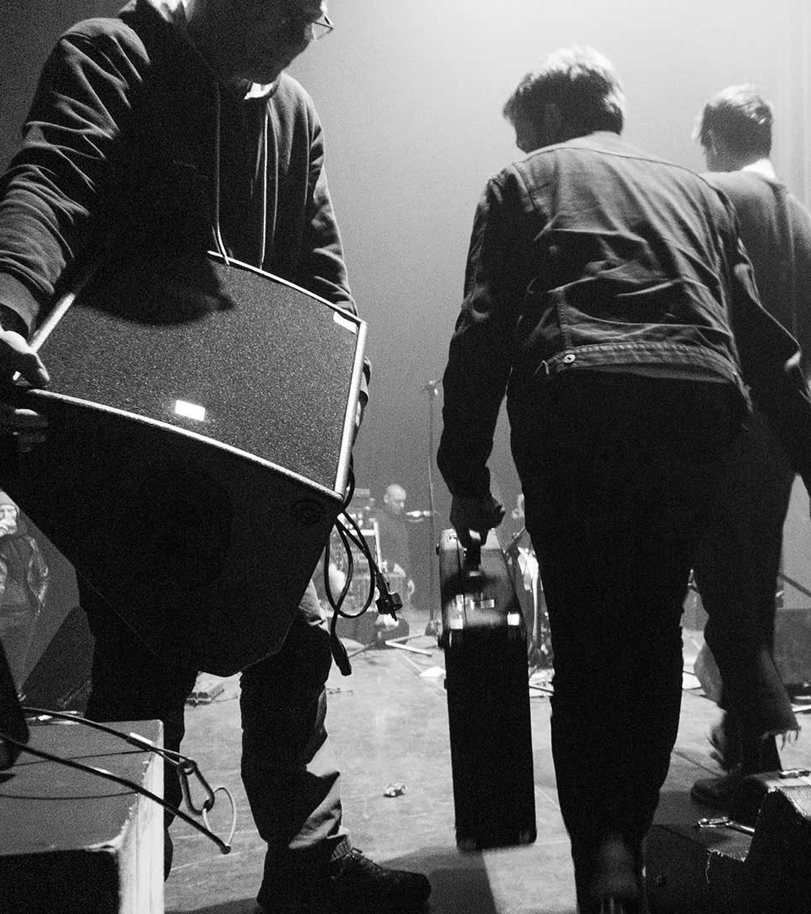
Ergonomics Defined
Definitions
The science of fitting the task to the worker to maximize productivity while reducing discomfort, fatigue, and injury.
Ergonomics is important for all workers, not just those that sit at a desk.
Ergonomics programs help organizations work more efficiently while reducing the incidence of MSDs.
Notes:
Ergonomics combines aspects of psychology, engineering, biomechanics, industrial design, and user experience to promote comfort, productivity, and safety.
The word “ergonomics” comes from the Greek words “ergon”, meaning “work”, and “nomos”, meaning “laws”. Therefore, ergonomics means the “laws of work”. In a practical sense, the job of an ergonomist is to ensure that workers’ tasks are within their abilities, both physically and mentally.
Ergonomics looks different in different settings. An office worker using a computer for 8 hours a day is exposed to different risks than someone lifting boxes in a warehouse. No matter the setting, however, ergonomists help employees and organizations work more efficiently while lowering the incidence of musculoskeletal disorders.

Slide 5

Musculoskeletal Disorders Defined
Definitions
  Injuries or disorders of the muscles, nerves, tendons, ligaments, joints, cartilage, and spinal discs.
  Work-related musculoskeletal disorders (WMSD) are conditions in which the work environment and performance of work contribute significantly to the condition
  Progression usually follows this path:
Fatigue and Stiffness
Intermittent Discomfort
Pain/Numbness
Loss of Function
Notes:
What are musculoskeletal disorders, you may be wondering?
When we misuse our bodies, they hurt, they get fatigued (or wear out), and things start to tear. We call those types of injuries “Musculoskeletal Disorders” As the name suggests, these are injuries to our musculoskeletal system – the parts of our bodies that allow us to move: muscles, nerves, tendons, ligaments, joints, cartilage, and spinal discs. These injuries occur over time as we repetitively overuse and misuse our muscles, tendons, and joints.
Think about a rubber band that is repeatedly over stretched or rubbed against a corner. What eventually happens to that rubber band? It starts to wear out and eventually it breaks. The same concept happens to our tendons and muscles when they are overused over a long period of time. These types of injuries may not seem as serious as the “blood and bruise” types of injuries, but these types of injuries can significantly impact your quality of life.
Typically, these disorders start with fatigue and stiffness in the affected area, then progress to intermittent discomfort, pain and/or numbness, and finally result in a loss of function.

Slide 6
Training Outline
Definitions
Musculoskeletal Disorders
Postural Risk Factors
Workstation Basics
Rest Breaks
Notes:
Now that we have defined some key terms, lets discuss musculoskeletal disorders, or MSDs, in more detail.

Slide 7
Common Symptoms of MSDs
Musculoskeletal disorders
  Numbness, tingling, burning, or shooting pain
  Limited strength, stiffness, limited range of motion
40%
  of all non-fatal work-related injuries and illnesses are MSDs!
Issue areas:
Neck
Low back
Shoulders
Forearms
Wrists
Notes:
As we already covered, MSDs can result in fatigue, stiffness, intermittent discomfort, pain, numbness, and loss of function. Other symptoms of MSDs are tingling, burning, or shooting pain as well as limited strength and range of motion.
Some common areas that affected by MSDs are the neck, low back, shoulders, forearms, elbows, and wrists.
Unfortunately, MSDs are relatively common and make up over 40% of all non-fatal work-related injuries and illnesses in the United States of America.
The good news is that these injuries can be avoided with good ergonomics.

Slide 8
MSD Risk Factors
Musculoskeletal disorders
Posture
Force
Repetition
Psychosocial
Ambient Environment
Load vs. capacity
Wide range of factors impact risk of developing a musculoskeletal disorder
Posture is important but not the only risk factor that we should try to control
Notes:
A wide range of factors impact your risk of developing a musculoskeletal disorder:
What postures you assume while working
How much force it takes to complete a given action
How many times that action is repeated in a work-day
How hot or cold your work environment is
And how much stress you are under in your role
In most cases, we have the most control over what postures we assume while working. By minimizing awkward postures and maximizing neutral postures, we have the best chance of working comfortably.

Slide 9
Training Outline
Definitions
Musculoskeletal Disorders
Postural Risk Factors
Workstation Basics
Rest Breaks
Notes:
Let’s spend the next couple of minutes taking a look at what awkward postures you should keep an eye out for while working.

Slide 10
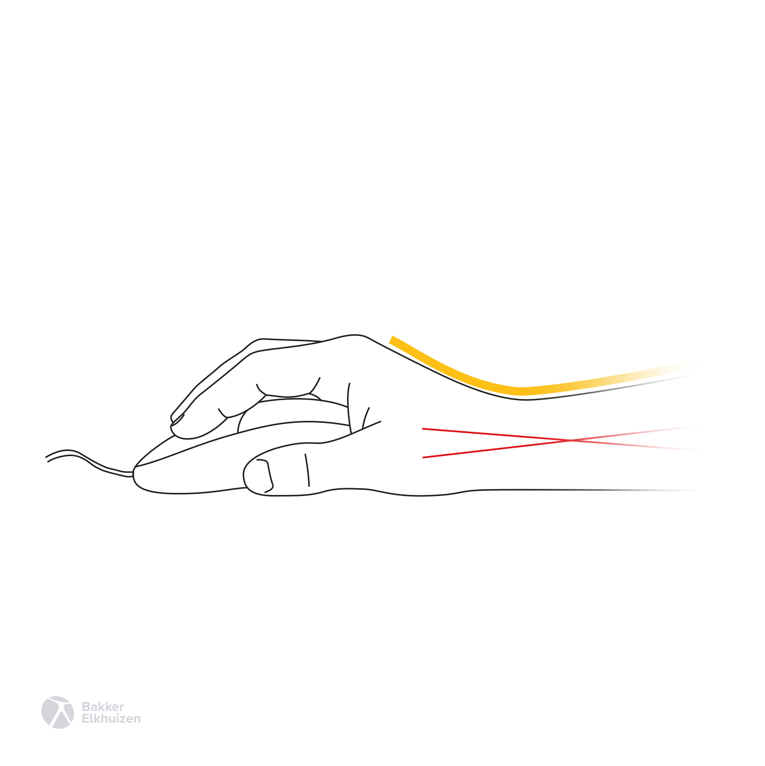
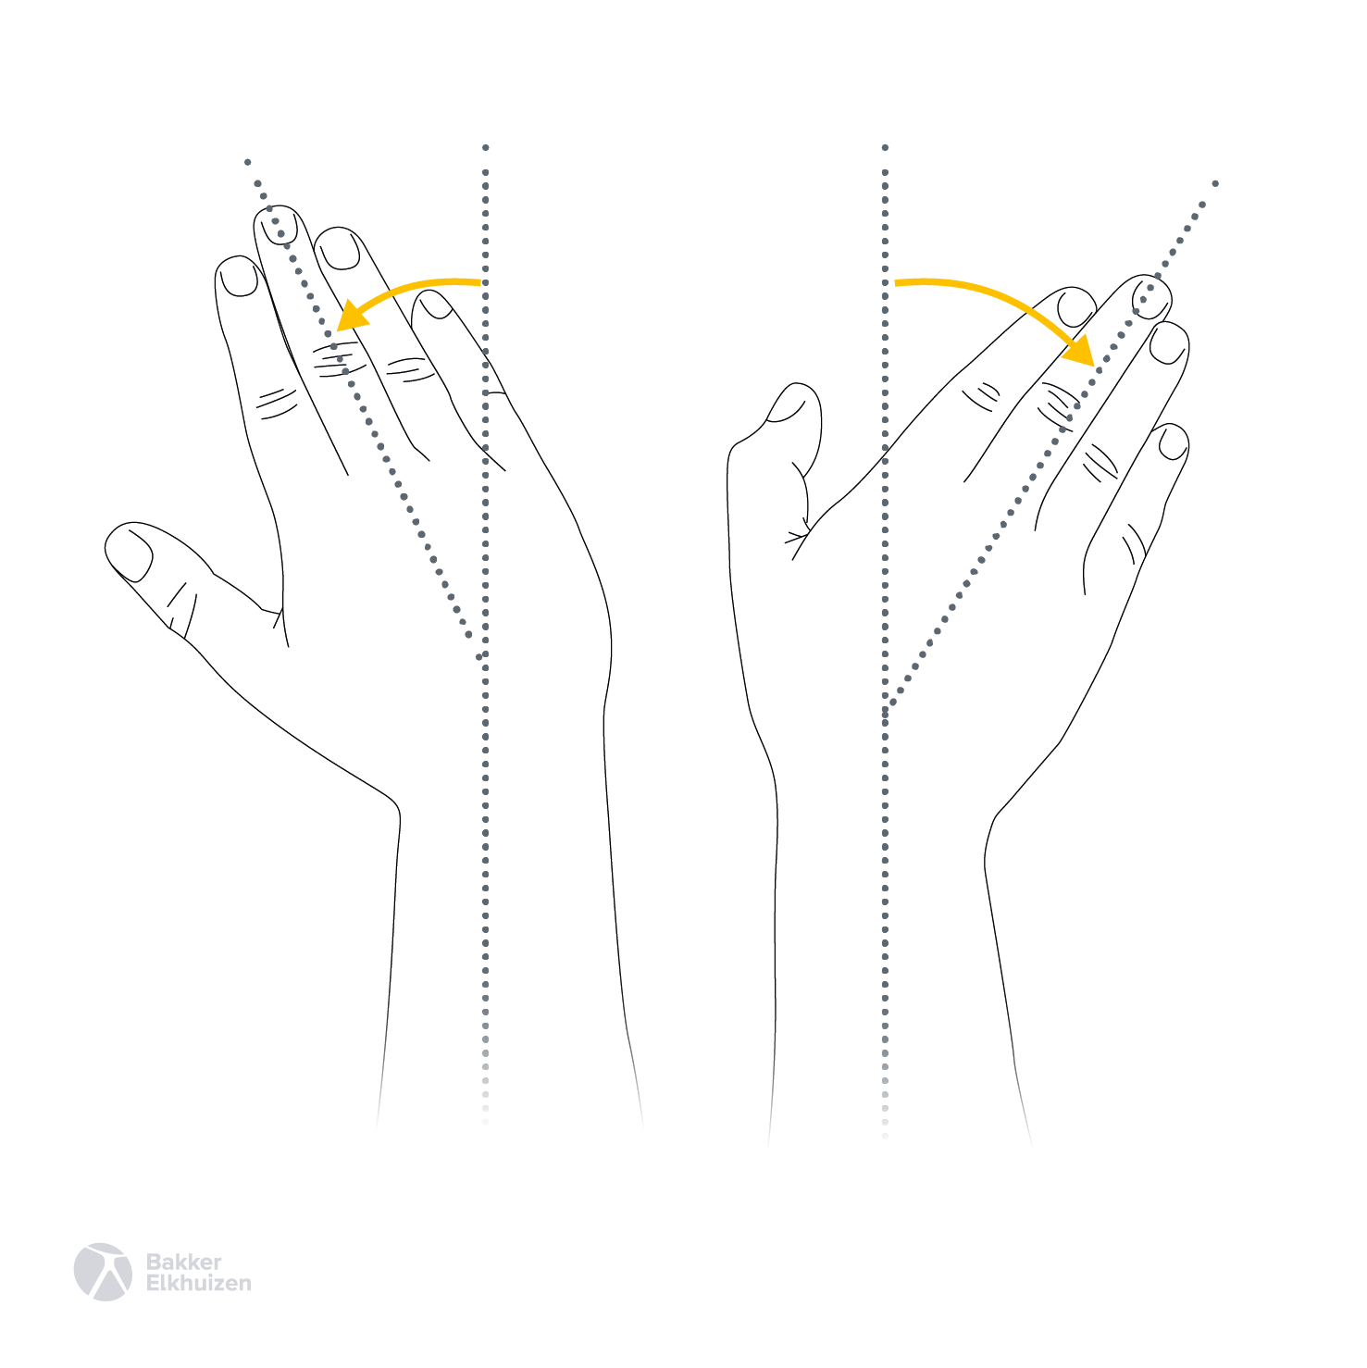
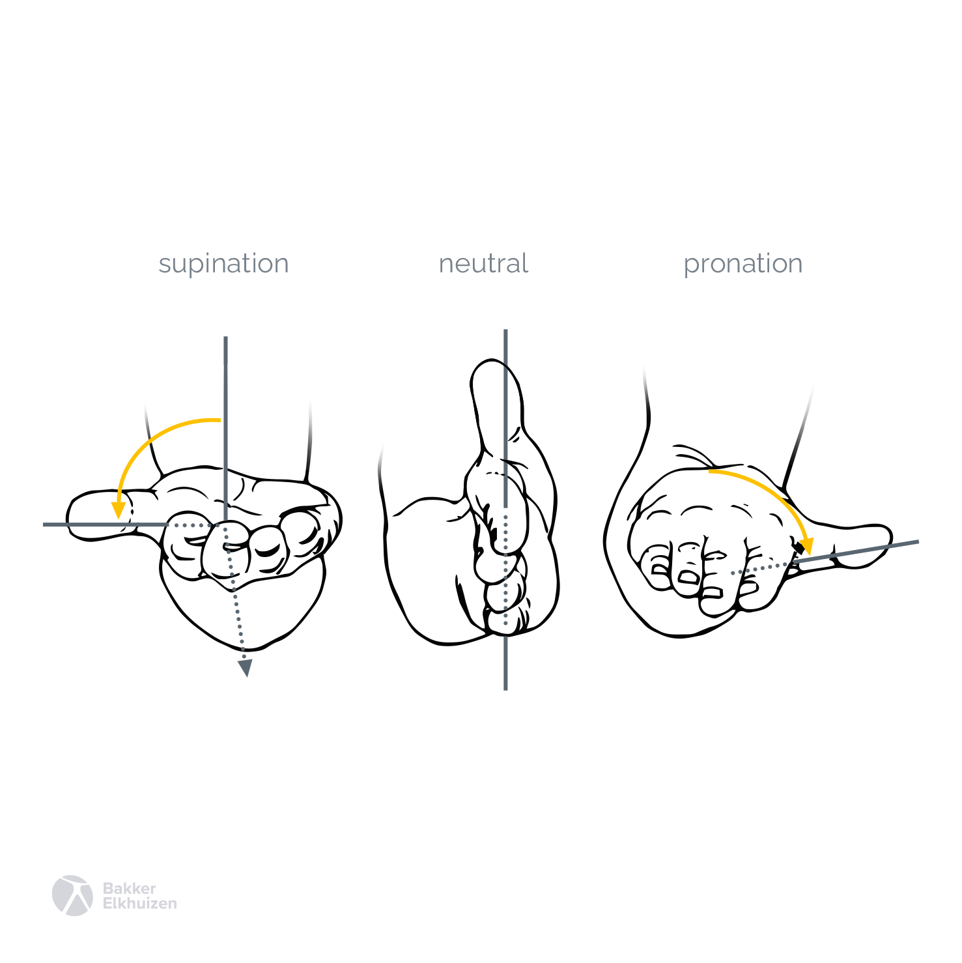
Wrist and Forearm
Postural risk factors
  Wrist Extension
  Radial Deviation
  Ulnar Deviation
  Forearm Supination
  Forearm Pronation
Notes:
Starting with the wrist and forearm, we should aim to avoid bending at the wrist.
Bending the hand back at the wrist is known as wrist extension and is common when gripping the mouse. An extended wrist posture can also result from the position of our work tools and type of work tools you are using. If the work tools are lower than elbow height, we tend to angle our forearms down and then extend the wrist back to use the keyboard and mouse. For example, if you place a keyboard or laptop in your lap, you’ll notice that you have to bend back your hands at the wrist to hit the keys. In addition, using the tabs on the underside of the keyboard to tilt the keyboard up can increase the degree of wrist extension while typing. The best solution for your wrists is to ensure you are working at a height in which you can work in a straight or neutral wrist posture. ​
Bending the hand side to side at the wrist is known as radial deviation when the hand is bent towards the center of the body, and ulnar deviation when bending towards the outside. This movement is common when moving the mouse.
Forearm pronation refers to twisting the forearm so the palm is facing down. Forearm supination refers to twisting the forearm so that the palm is facing up. Forearm pronation is common when typing and holding the mouse.

Slide 11
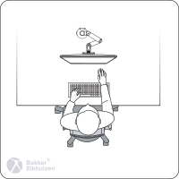
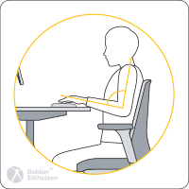
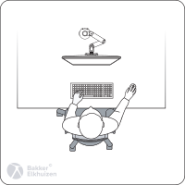
Arms and Shoulders
Postural risk factors
  Elbow Extension
  Shoulder Shrugging
  Shoulder Abduction
Notes:
Elbow extension occurs when reaching for objects in front of your body.
Shoulder shrugging refers to elevating your shoulder blades and can occur when the keyboard and mouse are too high or armrests are too high. Typically, you might hold your shoulders in an elevated position for a brief period and then rest your forearms on the desk surface to relieve some of the strain which can lead to additional ergonomic risks, as discussed in just a moment.
Shoulder abduction refers to spreading your upper arm away from your body and can occur as a result of reaching for the mouse.

Slide 12
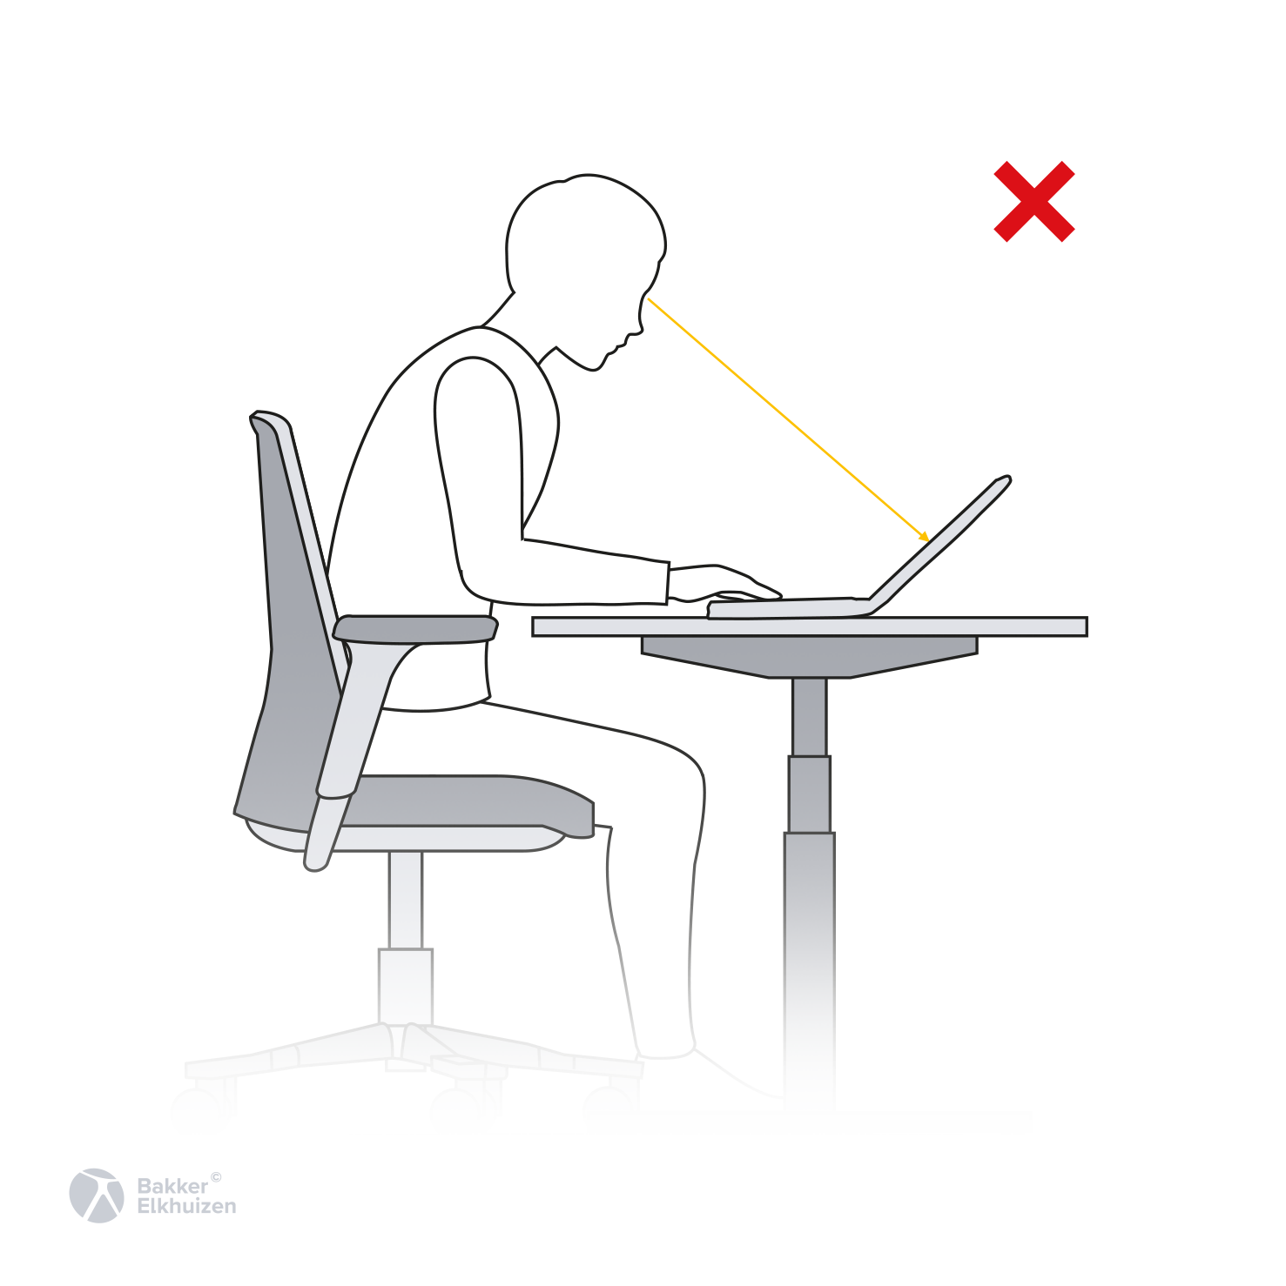
Trunk
Postural risk factors
  Flexion
Notes:
Trunk flexion is a fancy term for leaning forward. This puts excessive strain on the muscles in the back and changes the natural “S” shape of the spine, increasing the risk of low back pain.
The position of the objects you are interacting with – chair, keyboard, mouse, and monitor – can encourage this forward leaning seated posture. If the chair is too high and you cannot push against the ground or a footrest to maintain contact with the backrest, you will likely end up leaning forward before very long. In addition, if the keyboard and mouse are not within easy reach, you will have to lean forward to get to your tools. If the monitor is positioned too far from your body or too low, chances are you will lean forward to see items on the display.

Slide 13
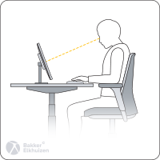
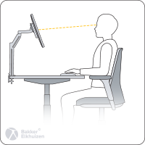
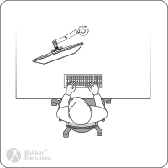
Neck
Postural risk factors
  Flexion
  Extension
  Rotation
Notes:
Neck flexion, or bending the head down, is common when using a laptop.
When the monitor is too high, you may experience neck extension, or bending your head backwards.
If the monitor is not aligned with your body, neck rotation is required to view the display.

Slide 14
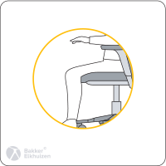
Contact Pressure
Postural risk factors
  Pressure on soft tissues close to surface:
    Blood vessels
    Tendons
    Nerves
Notes:
Slightly different from the postural risk factors, contact pressure refers to pressure on soft tissues such as blood vessels, tendons, or nerves which are positioned close to your skin.
When you use a mouse and plant your wrist on the desk surface, you may experience contact pressure on the tendons and nerve that run through the wrist. If your chair’s seat is deeper than the length of your thighs, you might experience contact pressure on the blood vessel at the back of your knees when you attempt to sit back in the chair.

Slide 15
Training Outline
Definitions
Musculoskeletal Disorders
Postural Risk Factors
Workstation Basics
Rest Breaks
Notes:
Now that we know what to avoid, what should we be aiming for? How can we adjust the workstation to mitigate the risk of developing a musculoskeletal disorder?

Slide 16
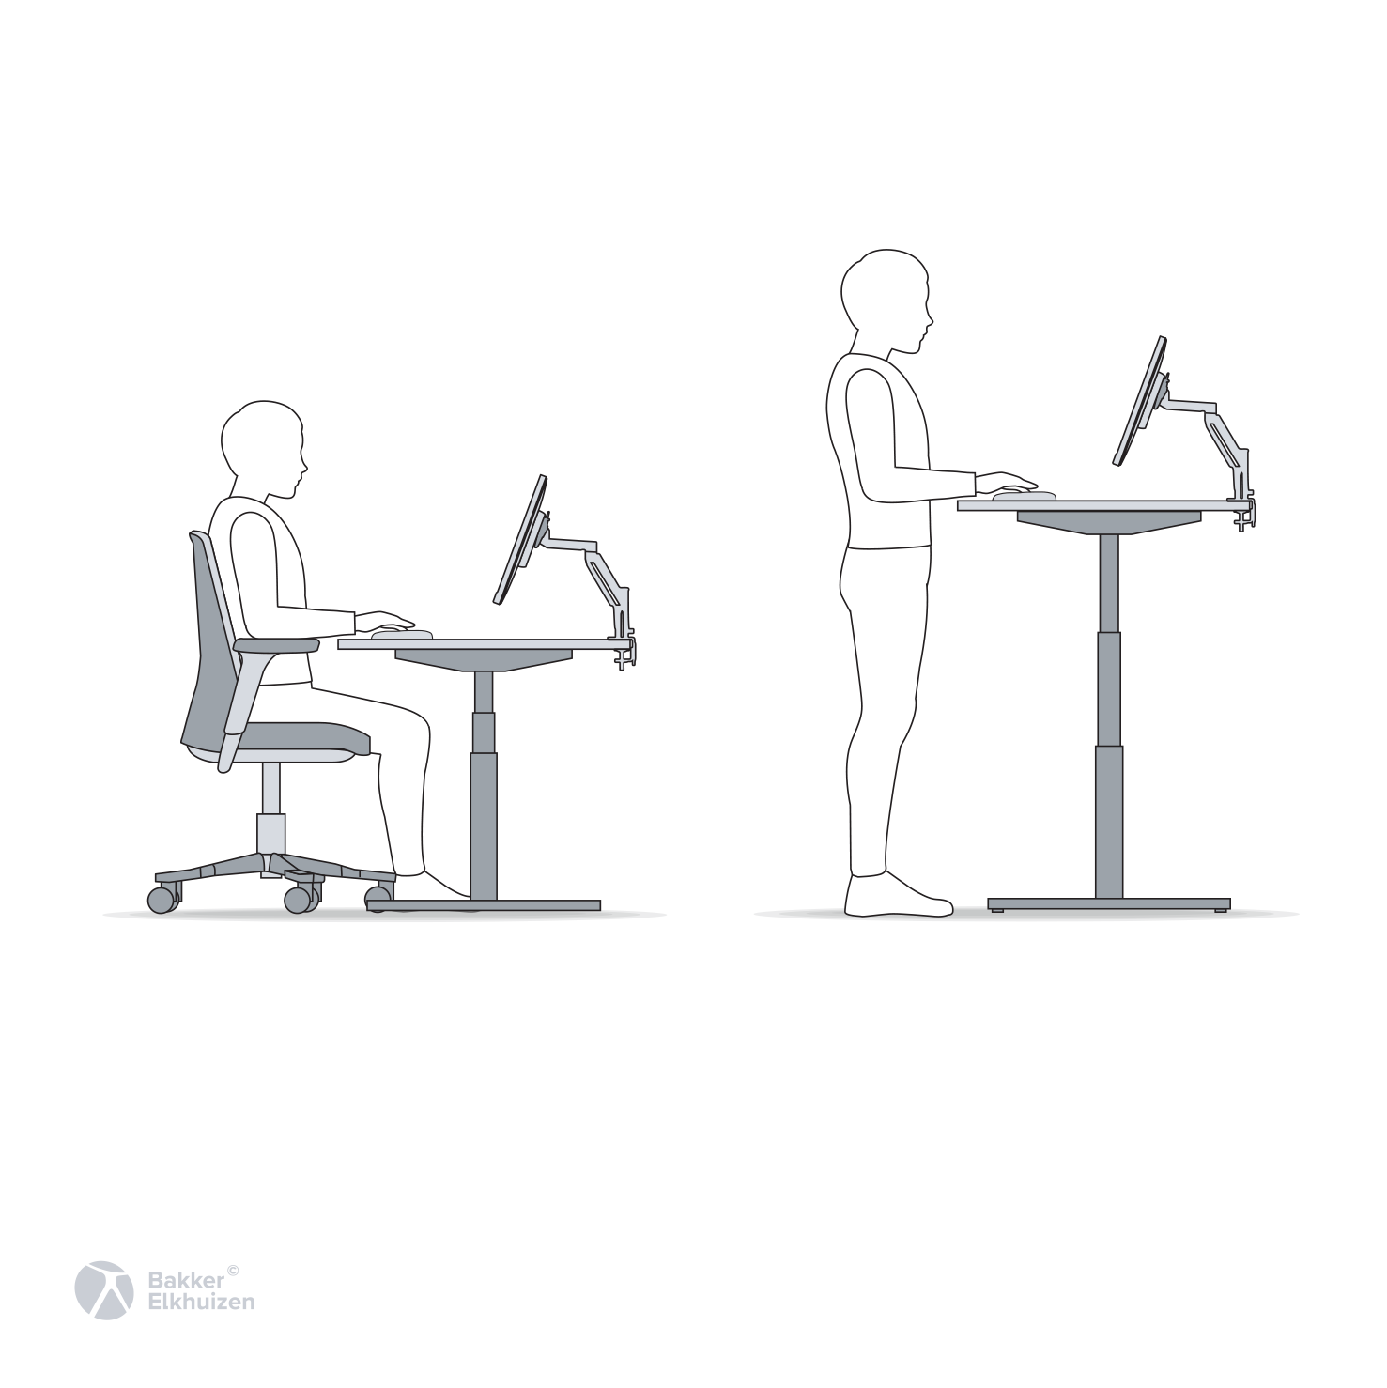
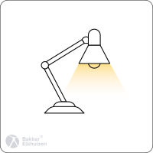
Components of a Computer Workstation
Workstation basics
3
  Chair
  Desk
  Monitor(s)
  Input Devices
  Lighting
5
4
2
1
Notes:
There are five components that we need to adjust to be able to work comfortably and safely:
The chair
The desk
The monitor(s)
The input devices
And the lighting
Let’s start by making sure you have the information you need to adjust the basics components of your computer workstation in a way that minimizes all these awkward postures. This is straightforward but usually needs to be repeated on a consistent basis so that you do not fall into old habits and focus only on your work and ignore what your body is telling you.

Slide 17
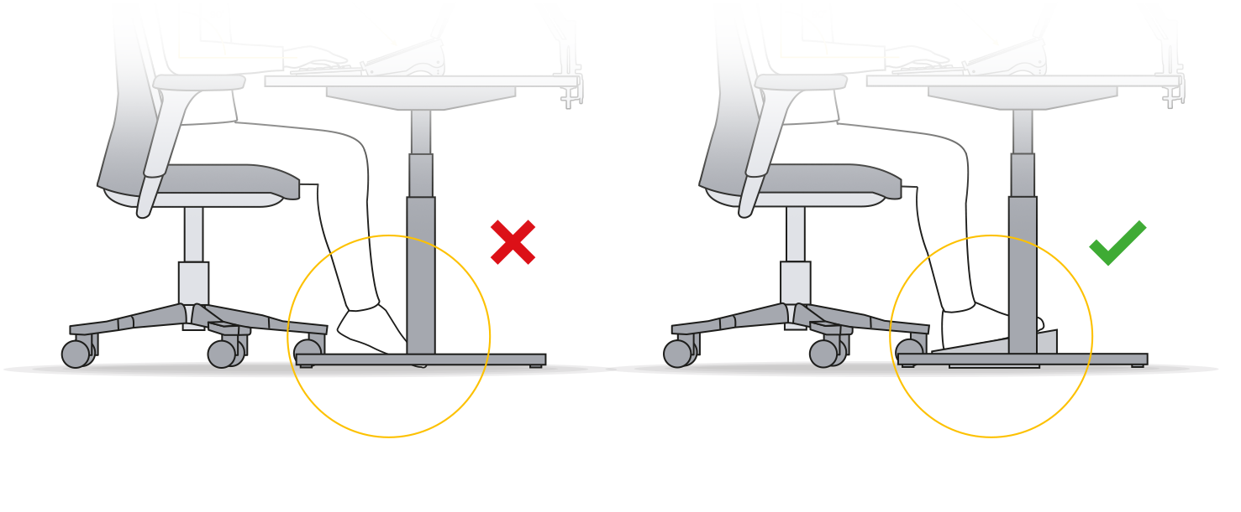
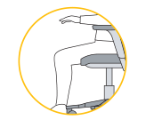
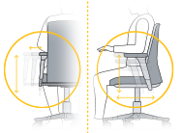
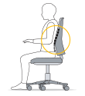
Chair Basics
Workstation basics
Knees level with hips
Feet supported by ground/footrest
2-3 in b/n edge of seat and knees
Your chair should have five adjustments to ensure that you can sit comfortably:
  Seat Height
  Seat Depth
  Armrest Height
  Lumbar Support Height
  Tilt Lock & Recline Tension
Armrests just below elbows
Roughly shoulder width apart
Aligned with low back curve
Backrest unlocked
Movement supported
Notes:
Seat height should be set so that your feet are flat on the ground and your knees are level with or slightly below your hips. The goal here is to avoid excessive pressure on the underside of your thighs and to ensure that you can push against the ground to maintain contact with the backrest.
Seat depth should be adjusted so that there is a slight gap, 2 to 3 inches, between the edge of the seat and the back of your knees. We want as much surface area as possible to distribute the weight of your body on your thighs but we do not want the edge of the seat to touch the back of your knees, as this can limit support for your lower back. This adjustment is easiest to make while standing, as the seat cannot move forward or back when there is weight on it.
Armrests should be positioned below your seated elbow height to help avoid unnecessary shoulder shrugging while working. Set the armrest height with your hands in your lap and your shoulders relaxed.
The chair’s lumbar support should be aligned with the curve in your lower back. If you are having trouble finding the right spot, feel for the deepest part of your lower back’s curve while you are standing. Leave your hand in the deepest part of the curve and then sit back down. That is where the lumbar support should be positioned to provide the most benefit for your body.
The chair’s backrest should be unlocked to allow you to shift your posture while working. The recline tension should be set to allow you to move easily while also supporting the weight of your torso. Too stiff, and it becomes difficult to move. Too loose, and it can feel like you are about to tip over in your chair. Aim for a middle ground based on your height and weight.

Slide 18
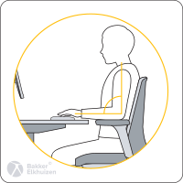
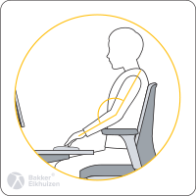
Desk Basics
Workstation basics
The worksurface should be positioned directly below your elbow height
This is true for seated and standing positions
Aim to alternate between sitting and standing at least once per hour if you have a sit/stand device
    45 minutes seated, 15 minutes standing per hour
Notes:
When using the computer, the keyboard and mouse should be positioned just below your seated elbow height. This is true when seated and when standing. If the desk is too high, you may have to compensate by raising your arms to use the keyboard and mouse. If the desk is too low, it can bang into your knees and thighs, and you may have to hunch over the desk or reach for the keyboard and mouse. Again, the desk should be positioned just below your elbow height.
If you are unable to adjust the desk height, consider using a keyboard tray to lower the keyboard and mouse or using a footrest to allow you to raise the seat and keep your legs fully supported.
If you have a sit/stand device, aim to spend 45 minutes seated and 15 minutes standing for every hour. Try to avoid for standing for more than 20 minutes at a time, as standing for an extended period can lead to foot, knee, and/or back discomfort. Standing should be viewed as a break from sitting – remember that the goal of a sit/stand device is to increase movement throughout the day.
Anti-fatigue mats are great if you do have to stand for a long time but they are not recommended for use in an office setting, as they can make it difficult to position your chair correctly relative to the rest of the workstation.

Slide 19
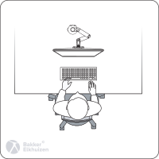
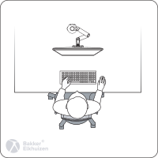
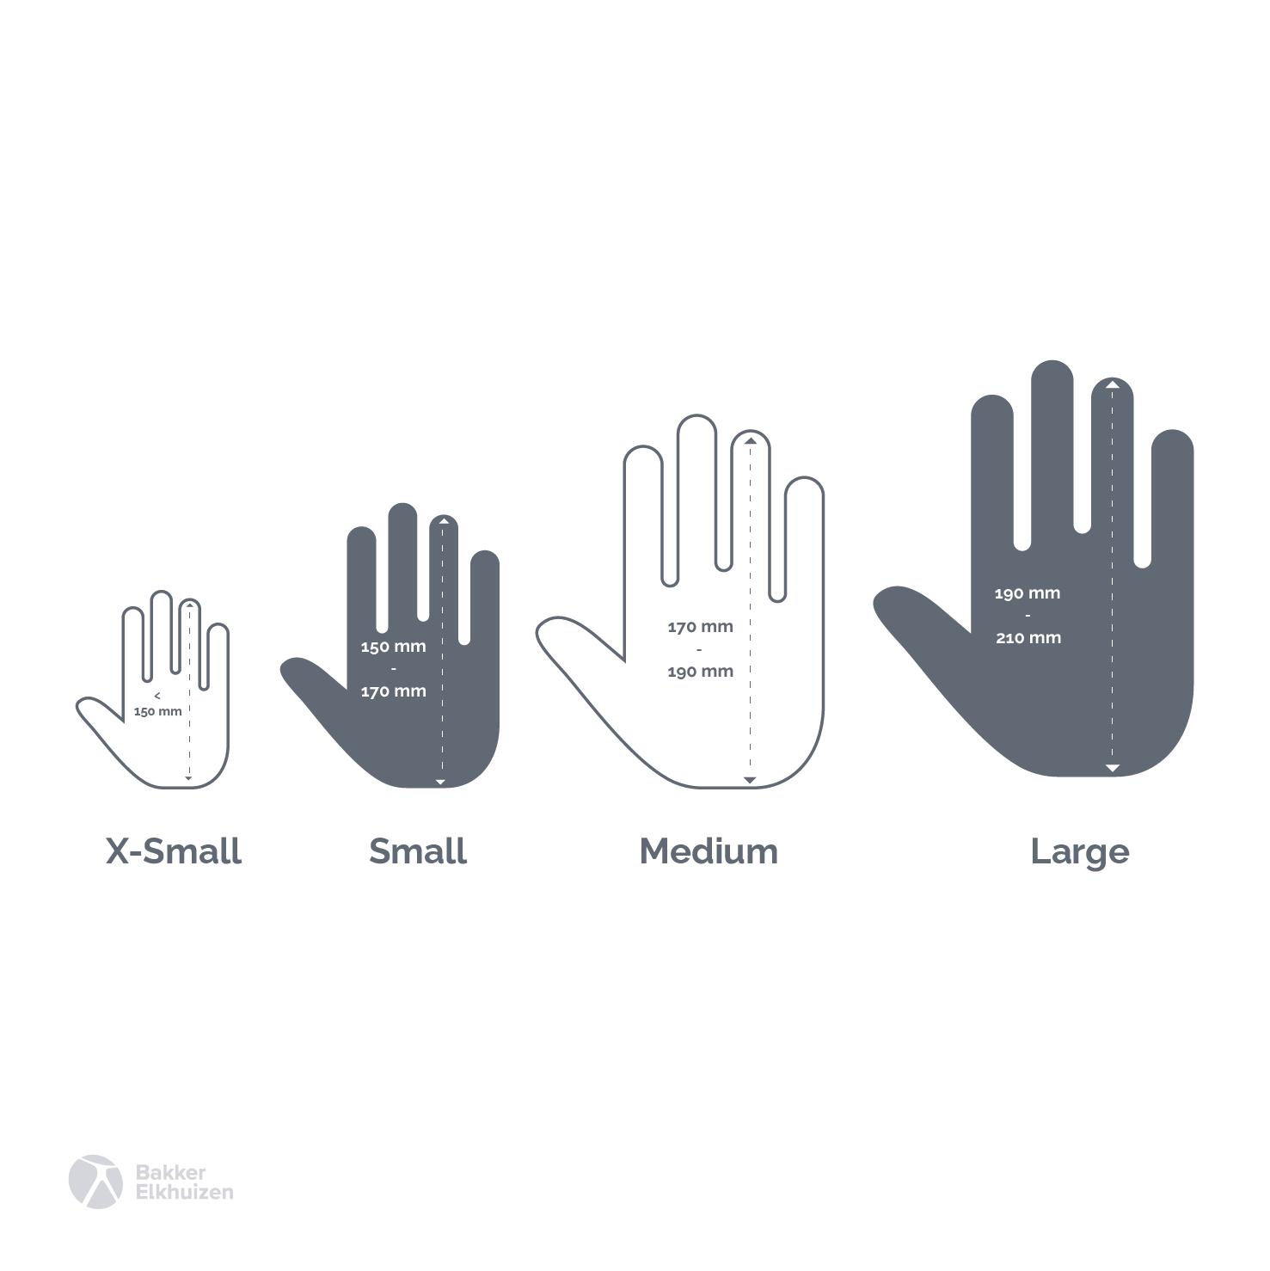
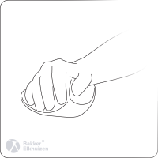
Input Device Basics
Workstation basics
Keyboard and mouse positioned so that elbows stay by sides
Avoid planting and pivoting when using mouse
    Aim to keep the wrist straight and flat, with movement originating at the shoulder
    Helpful to use appropriately sized mouse to help avoid pressure on wrist
Notes:
Input devices, or your keyboard and mouse, should be positioned to minimize reaching. If necessary, you can try using a compact keyboard to decrease the distance you have to reach to use the mouse.
When using the mouse, aim to keep your wrist straight and flat. Avoid planting your wrist on the desk and pivoting your hand from side to side and instead move your whole arm as a unit, with the movement starting at the shoulder rather than the wrist.

Slide 20
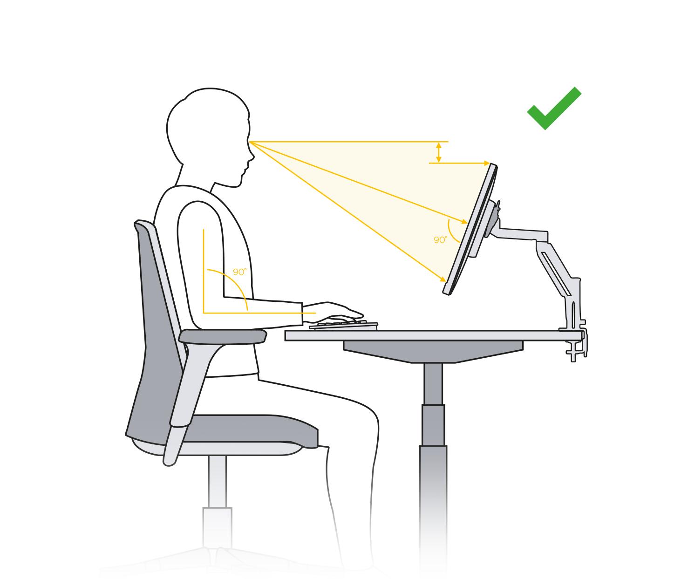
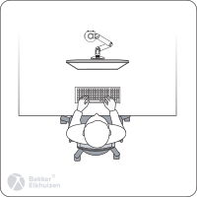
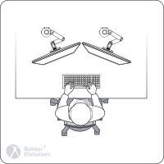
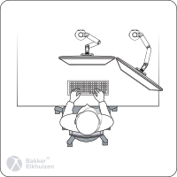
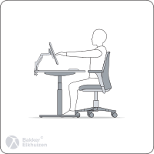
Monitor Basics
Workstation basics
Top of display at or just below eye level
If using bifocal or progressive lenses, lower display to avoid unnecessary neck extension
There are three considerations when adjusting your monitors:
  Height
  Arrangement
  Distance
Single Monitor
Position directly in front of your body
Two Monitors
50/50 use: arranged like a V so that seam between displays is directly in front of body
Primary/secondary: primary directly in front of body with secondary on left or right depending on personal preference
Display an arm’s length away
Fine tune based on eyesight
Aim to remain in contact with the backrest
Notes:
There are three aspects to consider when adjusting your monitor:
How high the screen is relative to your body
How far the screen is relative to your body
Where the screen is placed on the desk relative to your body
Monitor height should be set so that the top of the display is at or just below your eye level to avoid neck extension and flexion. If you wear bifocal or progressive lenses, lower the monitor avoid unnecessary neck extension.
You should be able to view the monitor easily without leaning forward. Generally, that means that the monitor should be positioned about an arm’s length from your body. If the monitor is too far, you may lean forward to view small items. If the monitor is too close, your eyes will have to work harder than is necessary to view the display.
If you have a single monitor, position the center of the display directly in front of your body to avoid neck rotation. If you have two monitors that you use evenly, 50/50, position the seam between the monitors directly in front of your body. If you a primary monitor and a secondary monitor, position the primary monitor directly in front of your body with the secondary monitor on the left or the right.

Slide 21
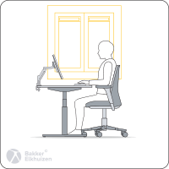
Lighting Basics
Workstation basics
Prolonged near work causes visual fatigue and ocular symptoms
    Eyestrain, headaches, blurred vision, dry eyes, etc.
Avoid positioning bright lights/surfaces (e.g. windows) behind monitors
Dim overhead lights and use a desk lamp to illuminate paper documents if needed
Notes:
Using a computer or other device for an extended period is a common source of eyestrain and headaches. Poor lighting can increase this risk.
Make sure to avoid positioning bright objects in your line of sight, including windows, light fixtures, and mirrors.
It is generally recommended to dim overhead lights, as we don’t need high light levels to view computer displays, and use a desk lamp to illuminate paper documents if needed.

Slide 22
Training Outline
Definitions
Musculoskeletal Disorders
Postural Risk Factors
Workstation Basics
Rest Breaks
Notes:
Even if the workstation is adjusted to fit your body perfectly, there is a good chance that you will experience discomfort if you do not take consistent breaks throughout the day.

Slide 23
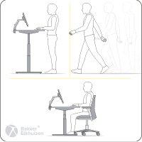
Movement is critical
Rest breaks
Movement is key to preventing discomfort
    Get up and move at least once per hour for 30-60 seconds
    Can use software to help with this, e.g. RSIGuard
Follow the 20/20/20 rule
    Every 20 minutes look at something more than 20 ft away for 20 seconds
Notes:
Movement is critical for preventing discomfort. Every hour, aim to get up and move for 30-60 seconds. Make sure to drink enough water throughout the day!
To help prevent eyestrain and headaches, follow the 20/20/20 rule:
Every 20 minutes, look at something more than 20 feet away for about 20 seconds.

Slide 24
Training Summary
Understand importance of ergonomics
Identify common risk factors that may increase injury risk
Adjusting your workstation set-up
Practice healthy work habits and techniques
Select the proper work tools and equipment
Know how to obtain additional assistance if needed
Notes:
Here’s a summary from today’s session:

